Slide 1

SPECTRUM SWITCH
De Vera, Kenneth
Lopez, Marienne
Sabellon, Aileen Benz

Slide 2
ART BIBLE

Slide 3

ART STYLE

Slide 4




CHARACTER ART

Slide 5

LEVEL OF DETAILS

Slide 6




CAMERA
SIDE SCROLLER POINT OF VIEW

Slide 7
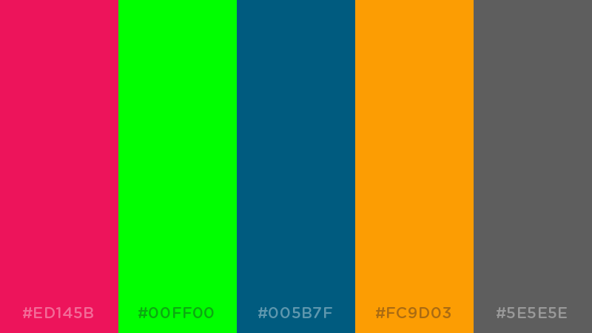







COLOR PALETTE
USES WARM AND COOL COLORS
THAT MAY WORK FOR CASUAL AUDIENCE
AND MAKE THE GAME FEEL PUZZLE PACKED

Slide 8
ATMOSPHERE OR ENVIRONMENT

Slide 9
USER INTERFACE

Slide 10
TECHNICAL GUIDELINES

Slide 11
REFERENCES/MOOD BOARDS

